Slide 1


Nguyen Thai Huy
Tuesday 7 March 2023

Slide 2

Outline
Executive Summary
Introduction
Methodology
Results
Conclusion
Appendix

Slide 3
Executive Summary
Summary of methodologies
Data Collection using SpaceX API and web scraping
Exploratory Data Analysis (EDA), including data wrangling, data visualisation and interactive visual analytics
Machine Learning Prediction
Summary of all results
It was possible to collect useful data from public sources
EDA enabled us to determine which features best predict the success of launches
Using all collected data, Machine Learning Prediction revealed the best model for predicting which characteristics are important to drive this opportunity

Slide 4
Introduction
Background
an alternate company wants to bid against SpaceX for a rocket launch
Objectives
predict if the Falcon 9 first stage will land successfully
determine the cost of a launch
Findings
the best place to make launches
the best method for estimating total launch costs by predicting successful first-stage rocket landings

Slide 5


Slide 6
Methodology
Executive Summary
Data collection methodology
SpaceX data was obtained from two sources: the Space X API and Wikipedia
Perform data wrangling
Perform some Exploratory Data Analysis (EDA) to find some patterns in the data and determined what would be the label for training supervised models
Perform exploratory data analysis (EDA) using visualisation and SQL
Perform interactive visual analytics using Folium and Plotly Dash
Perform predictive analysis using classification models
Normalise the data collected up to this point
Train and test the dataset by four different classification models
Evaluate the accuracy of each model using different parameter combinations

Slide 7
Data Collection
SpaceX data was collected from two sources:
the Space X API (https://api.spacexdata.com/v4/rockets/)
web scraping (https://en.wikipedia.org/wiki/List of Falcon/ 9/ and Falcon Heavy launches/)

Slide 8
Data Collection – SpaceX API
Request and Parse the SpaceX Launch Data
Filter the data to only Include Falcon 9 Launches
Data Wrangling: Dealing with Missing Values
Use the GET request and parse the SpaceX launch data
Filter data using the BoosterVersion column to only keep Falcon 9 launches
Do some basic data wrangling and formatting for missing values
The SpaceX API Data Collection Process
HERE is the GitHub URL of the completed interactive map with Folium notebook, as an external reference.

Slide 9
Data Collection - Scraping
Perform an HTTP GET method to request the Falcon9 Launch HTML Wiki page, as an HTTP response
Extract all column/variable names from the HTML table header
Parse the launch record values into a dictionary and created a data frame from it
Request the Falcon9 Launch Wiki page from its URL
Extract all column names from the HTML table header
Create a data frame by parsing the launch HTML tables
The Web Scraping Data Collection Process
HERE is the GitHub URL of the completed interactive map with Folium notebook, as an external reference.

Slide 10
Data Wrangling
EDA
Calculating
Determining Training Labels
Calculate the number of launches on each site, number and occurrence of each orbit and of mission outcome per orbit type
Convert values in the Outcome into Training Labels with 1 means the booster successfully landed, 0 means it was unsuccessful
Perform some EDA on the SpaceX data set from last section
The Data Wrangling Process
HERE is the GitHub URL of the completed interactive map with Folium notebook, as an external reference.

Slide 11
EDA with Data Visualisation
Scatter plots visualise the correlation between numerical variables.
Bar plot illustrates the relationship between numerical and categorical variables.
Line graph was used to track changes over a short or long periods of time. It can also make prediction for unseen data.
Scatter plots:
Flight Number and Launch Site
Payload and Launch Site
Flight Number and Orbit type
Payload and Orbit type
Bar plot:
Success Rate of Each Orbit Type
Line graph:
Launch Success Yearly Trend
HERE is the GitHub URL of the completed EDA with data visualisation notebook, as an external reference.

Slide 12
EDA with SQL
The following SQL queries were performed to gather and understand data:
List the names of the unique launch sites in space mission
Display the 5 records where launch sites begin with ‘CCA’
Show the total payload mass carried by boosters launched by NASA (CRS)
Find the average payload mass carried by booster version F9 v1.1
Find the date when the first successful landing outcome in ground pad was achieved
List the names of the boosters which have success in drone ship and its payload mass in between 4000 and 6000 kg
Find the total number of successful and failure mission outcomes
List the names of the booster_versions which have carried the maximum payload mass
Display the records which will display the failure landing_outcomes in drone ship, booster versions, launch site for the months in year 2015
Rank the count of successful landing_outcomes between the date 4 Jun 2016 and 20 Mar 2017 in descending order
HERE is the GitHub URL of the completed EDA with SQL notebook, as an external reference.

Slide 13
Build an Interactive Map with Folium
Markers, circles, lines and marker clusters were created and added to the folium maps to better understand the problem and the data
The red circles at several location display theirs coordinate, and the labels reveal theirs name
The cluster of points show multiple and distinct information for the same coordinates
Green markers represent the successful landings, whilst red markers represent the failed landings
The coloured lines indicate the distance between the launch site and key locations (railway, motorway, coastline, and city)
HERE is the GitHub URL of the completed interactive map with Folium notebook, as an external reference.

Slide 14
Build a Dashboard with Plotly Dash
The dashboard includes dropdown, pie chart, range slider and scatter plot elements
The Dropdown allows a user to select a specific launch site or all launch sites
The pie chart displays both the total success and total failure for the launch site selected
Range slider is used to select a payload mass in a fixed range
Scatter chart illustrates the relationship between two variables, in particular Success vs Payload Mass
HERE is the GitHub URL and HERE are the screenshots of the completed Plotly Dash lab, as an external reference.

Slide 15
Predictive Analysis (Classification)
Data preparation
Load the data set
Normalise and standardise data
Split data into training and test sets
Model preparation
Choose and set parameters for each of four machine algorithms (logistic, SVM, Decision Tree and KNN) to GridSearchCV
Train each GridSearchCV model using the training set
Model evaluation
Get best hyperparameters for each type of model
Evaluate the accuracy for each model using two data sets
Plot the confusion matrix
Model comparison
Compare four models according to their accuracy
Select the model with the highest accuracy score
HERE is the GitHub URL of the completed interactive map with Folium notebook, as an external reference.

Slide 16
Results
Exploratory data analysis results
Interactive analytics demo in screenshots
Predictive analysis results

Slide 17


Slide 18
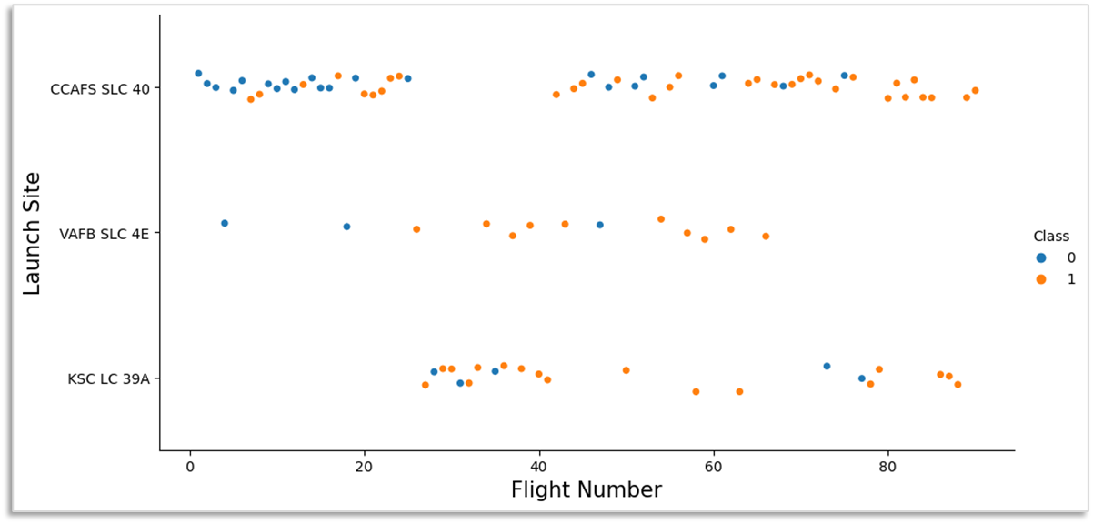
Flight Number vs Launch Site
The greater the number of flights on each launch site, the higher the success rate
The best launch site is KSC LC 39A, where the most past and recent launches were successful
Scatter plot of Flight Number vs Launch Site

Slide 19
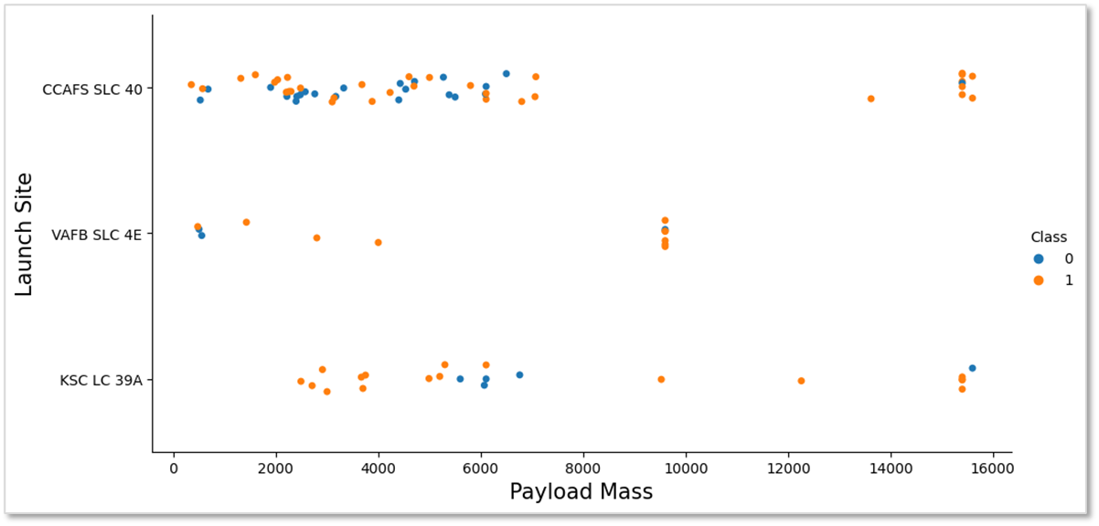
Payload vs Launch Site
Depending on the launch site, a heavier payload may be necessary for a successful launch
Payloads weighing more than 7,000 kg have a high success rate.
However, there is no definite pattern to suggest that the success rate of a launch depends on the payload mass or the launch site.
Scatter plot of Payload Mass vs Launch Site

Slide 20
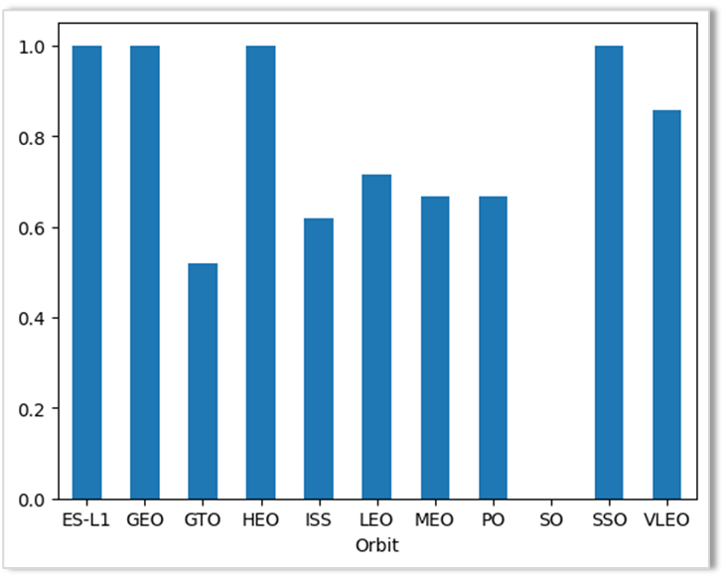
Success Rate vs Orbit Type
The ES-L1, GEO, HEO and SSO orbits have a significant high success rate (nearly 100%), whereas the SO orbit produced 0% rate of success.
However, deeper analysis revealed that some of these orbits, like GEO, SO, HEO, and ES-L1, only occurred once, so more datasets are required to see certain patterns or trends before we can draw any conclusion.
Bar chart for the success rate of each orbit

Slide 21
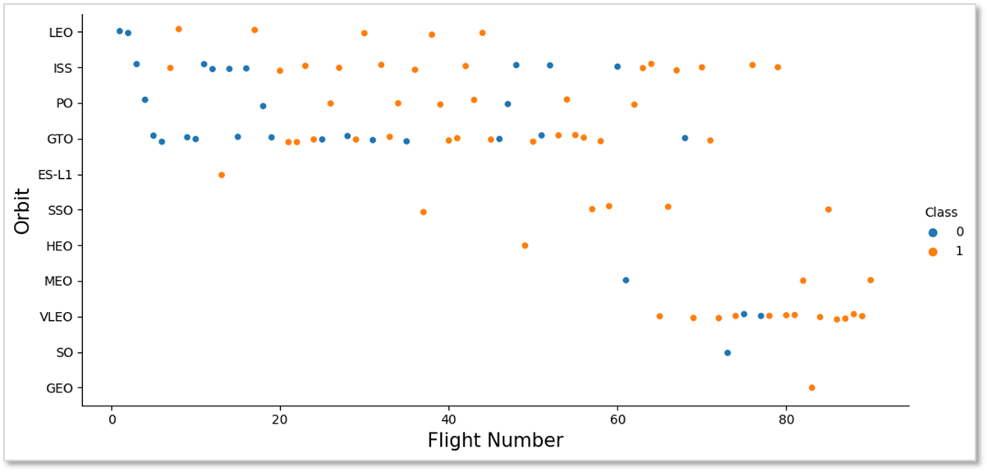
Flight Number vs Orbit Type
As the number of flights increased, so did the success rates in certain orbits
Except for GTO, the greater the number of flights on each orbit, the higher the success rate (especially on LEO orbit).
As mentioned above, orbit that only occurred once should be excluded from the analysis.
Scatter plot of Flight Number vs Orbit Type

Slide 22
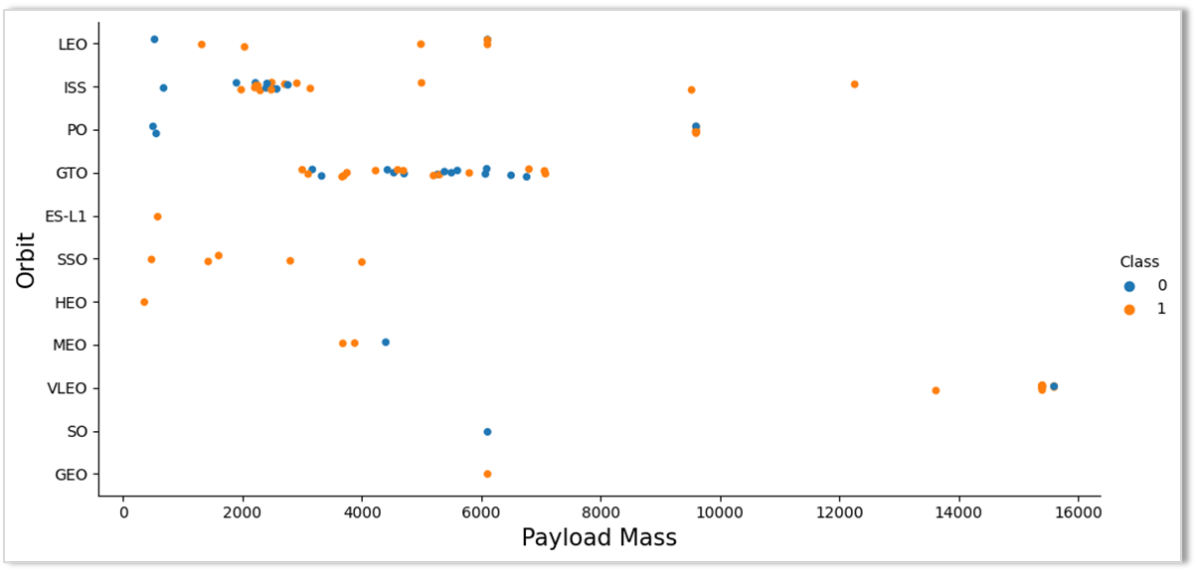
Payload vs Orbit Type
The weight of payloads may have positive or negative impacts on the success rate of launches depending on specific orbit type
The attributes appear to have no relationship in the GTO orbit.
Again, more datasets are required to observe patterns or trends in the SO, GEO, ES-L1 and HEO orbits.
Scatter plot of Payload vs Orbit Type

Slide 23
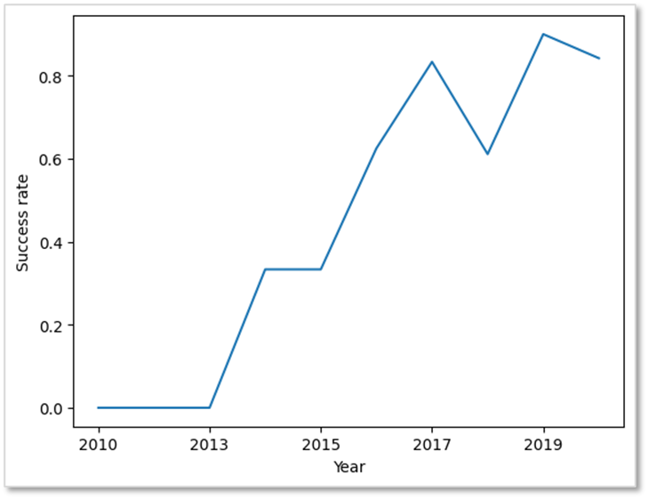
Launch Success Yearly Trend
From 2013 to 2020, the SpaceX success rate has increased rapidly
There have been no changes in the first three years, it may be a period of adjustment and technological advancement
Line chart for the average launch success yearly trend

Slide 24
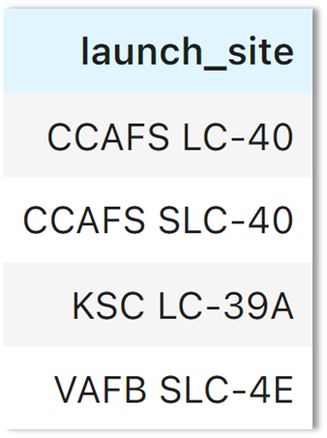
All Launch Site Names
Find the names of the unique launch sites
The use of DISTINCT in the query is to select the unique ‘launch_site’ names from the data set

Slide 25
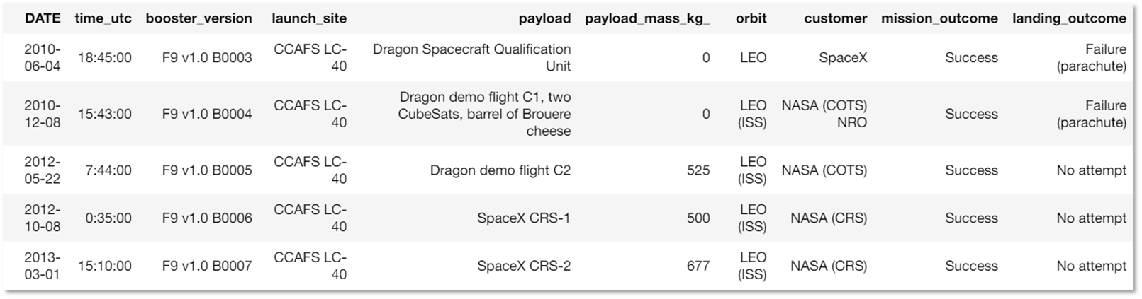
Launch Site Names Begin with 'CCA'
Find 5 records where launch sites begin with ‘CCA’
The WHERE clause, followed by the LIKE clause, filtered out launch sites with the prefix ‘CCA’. LIMIT 5 displays the first 5 records from the filtered set.

Slide 26
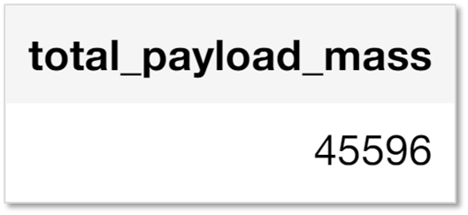
Total Payload Mass
Calculate the total payloads carried by booster from NASA (CRS)

Slide 27

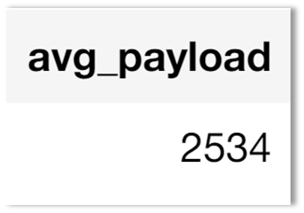
Average Payload Mass by F9 v1.1
Calculate the average payload mass carried by booster version F9 v1.1
This query returned the average of all payload masses where the booster version contains the substring ‘F9 v1.1’, which is 2534 kg

Slide 28
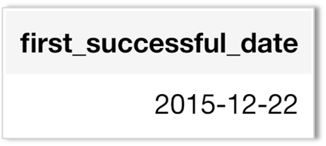
First Successful Ground Landing Date
Find the dates of the first successful landing outcome on ground pad
The WHERE clause filtered the data set in order to keep only records where landing on ground pad was successful.
The MIN function returned the record with the oldest date.

Slide 29
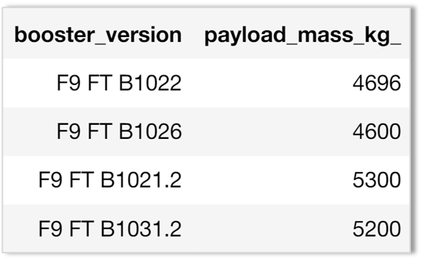
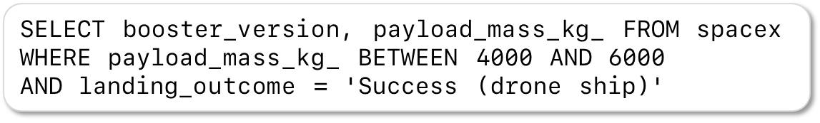
Successful Drone Ship Landing with Payload between 4000 and 6000
List the names of boosters which have successfully landed on drone ship and had payload mass greater than 4,000 kg but less than 6,000 kg

Slide 30

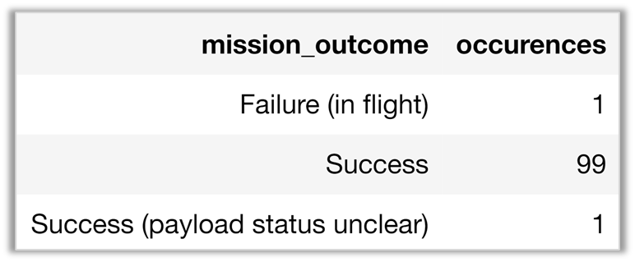
Total Number of Successful and Failure Mission Outcomes
Calculate the total number of successful and failure mission outcomes
Grouping mission outcomes and counting records for each group led us to the summary below

Slide 31
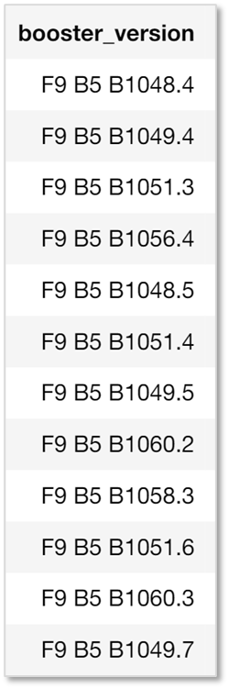
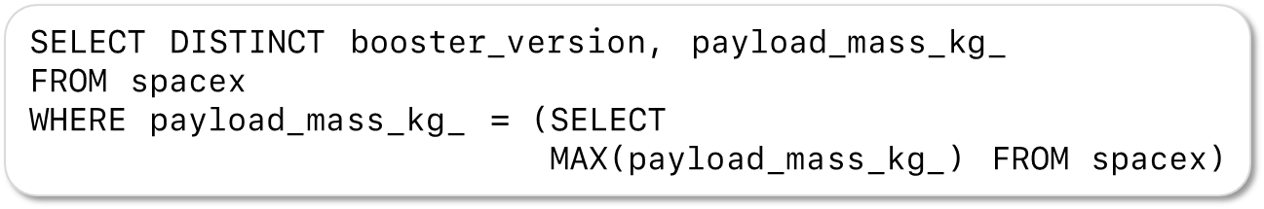
Boosters Carried Maximum Payload
List the names of the booster which have carried the maximum payload mass
The subquery filtered the data by returning only the heaviest payload mass with the MAX function.
The main query used the subquery results and returned unique booster version (SELECT DISTINCT) with the heaviest payload mass.

Slide 32
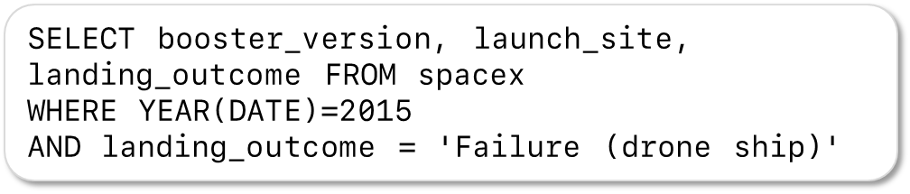
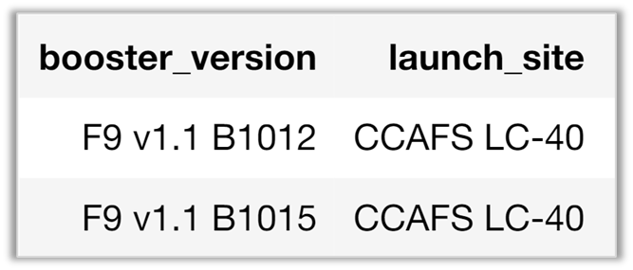
2015 Launch Records
List the failed landing_outcomes in drone ship, their booster versions, and launch site names for in year 2015
This query returned booster versions and launch sites where landing was failed within 2015.
YEAR(DATE) extracted the year in DATE column.

Slide 33
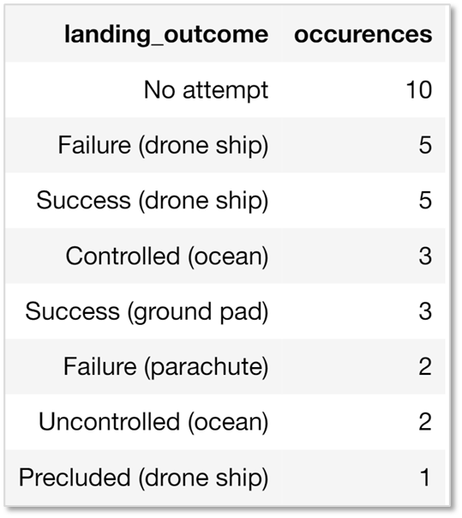
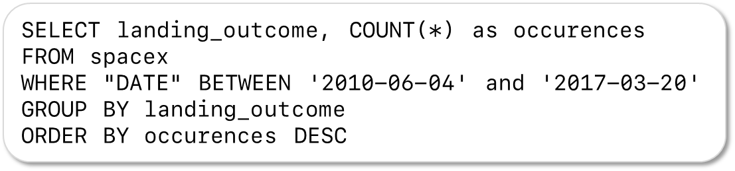
Rank Landing Outcomes Between 2010-06-04 and 2017-03-20
This query ranked landing outcomes by their number of occurrences from 4 Jun 2010 to 20 Mar 2017. The GROUP BY clause grouped the results by landing outcome and ORDER BY DESC displayed the results in descending order of occurrences.

Slide 34

Section 3

Slide 35
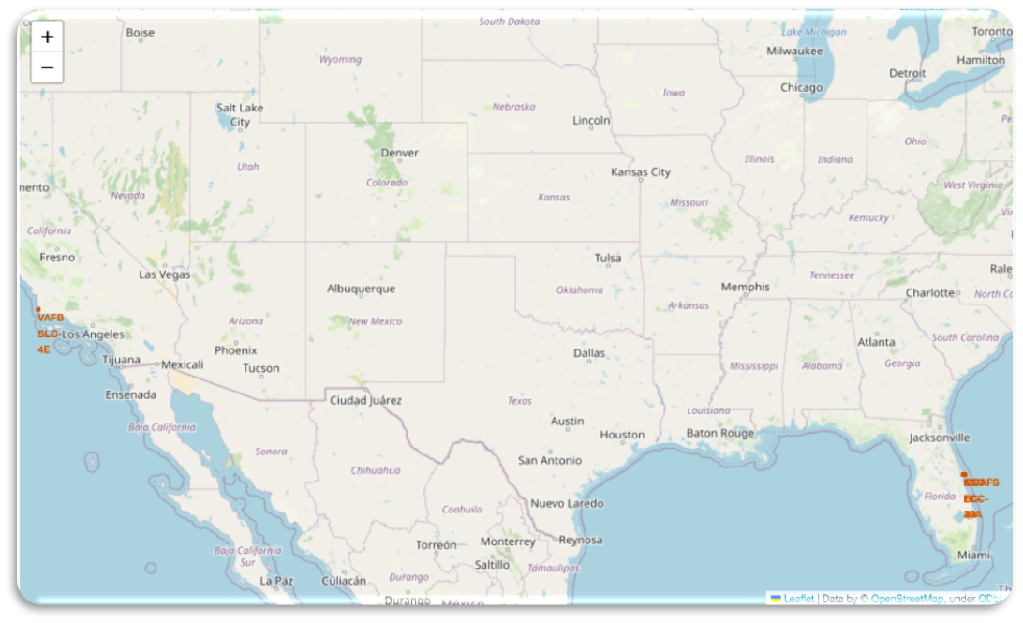
All launch sites
Launch sites are located on the coast of the United States, probably for safety, but not too far from roads and railways.

Slide 36
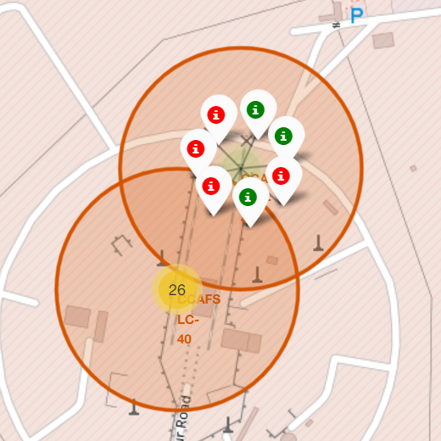
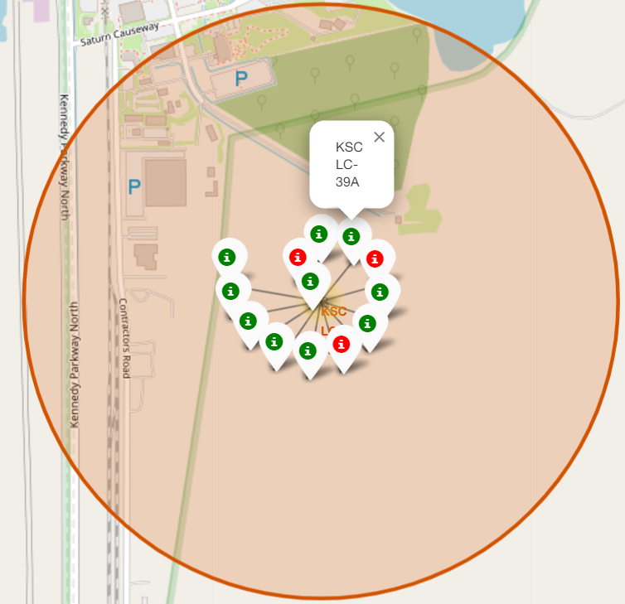
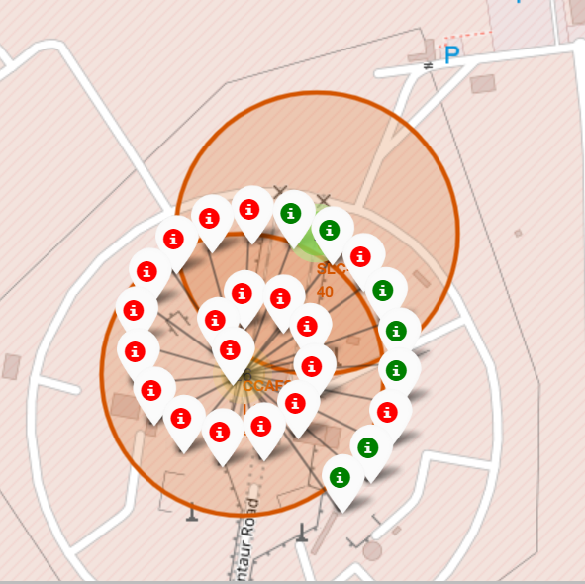
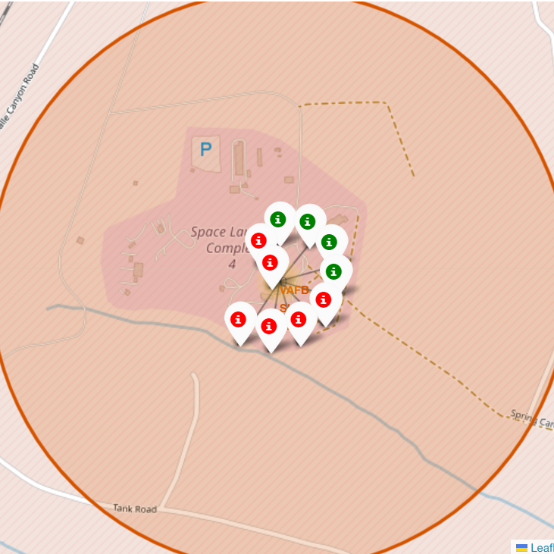
The colour-labelled launch site
The green marker denotes successful launches. The red marker denotes failed launches. We notice that the KSC LC-39A has a higher success rate.

Slide 37
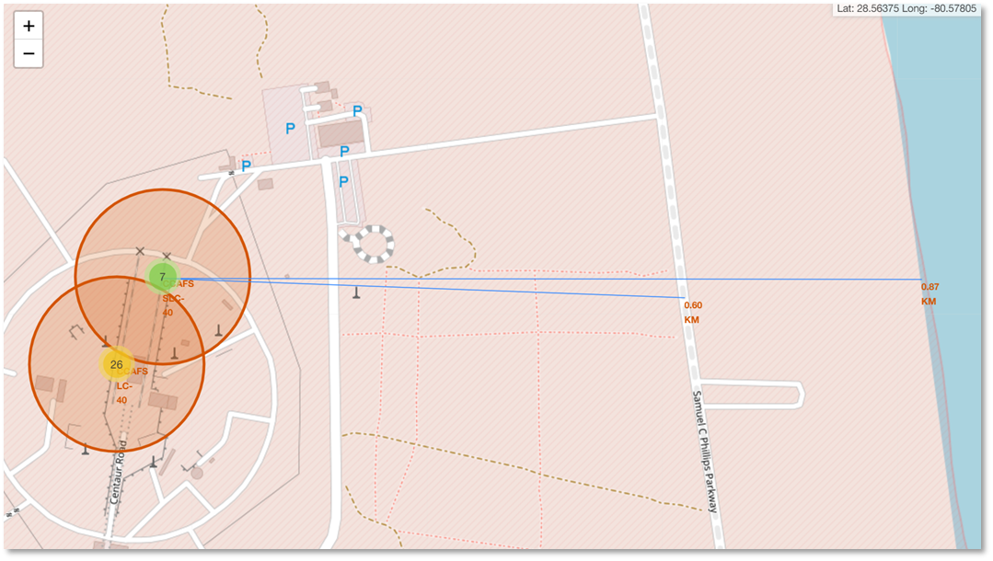
Logistics and Safety
The launch site CCAFS SLC-40 has good logistics infrastructure, as it located in close proximity to railways, highways, coastline and relatively far from cities

Slide 38

Section 4

Slide 39
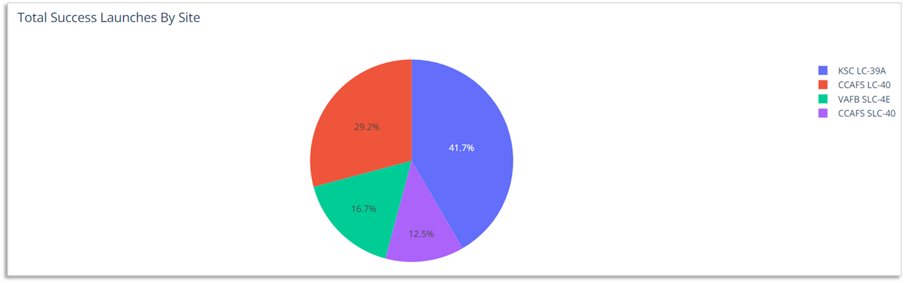
Total Successful Launches by Site
Launch site appears to be an important factor of a successful mission
KSC LC-39A stands out to be the best launch site with the success rate of 41.7%

Slide 40
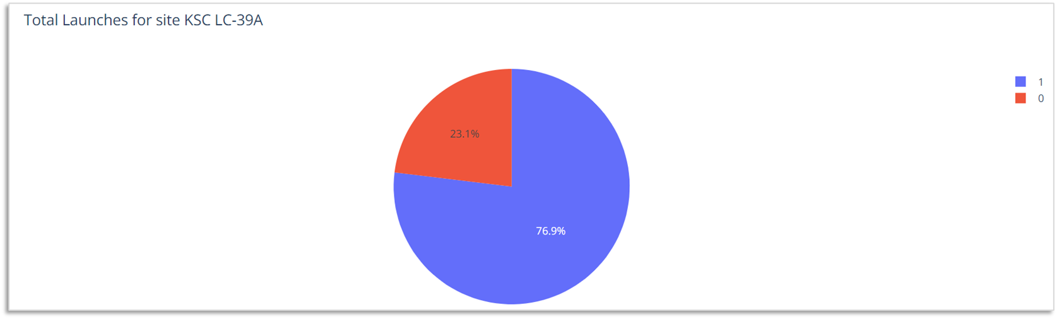
Launch Success Ratio for KSC LC-39A
76.9% of launches are successful in the launch site KSC LC-39A

Slide 41
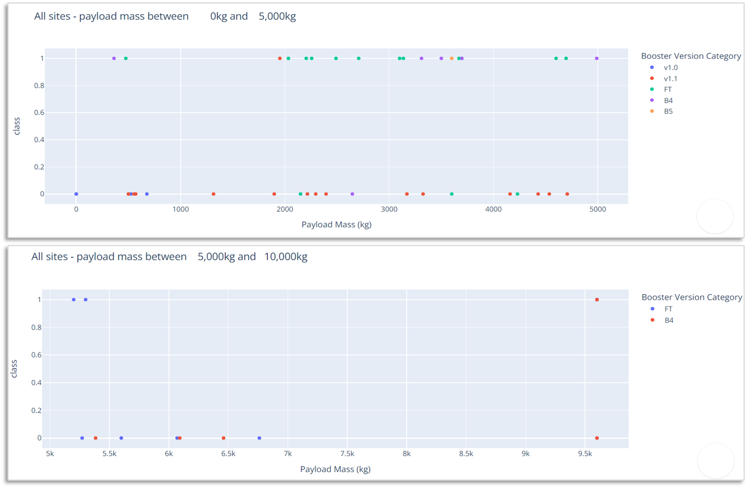
Payload Mass vs Outcome for all sites with different payload mass selected
Low weighted payloads have a higher success rate than heavy weighted payloads.
There is insufficient information to comment on payloads ranging from 7,000 to 9,500 kg.

Slide 42

Section 5

Slide 43
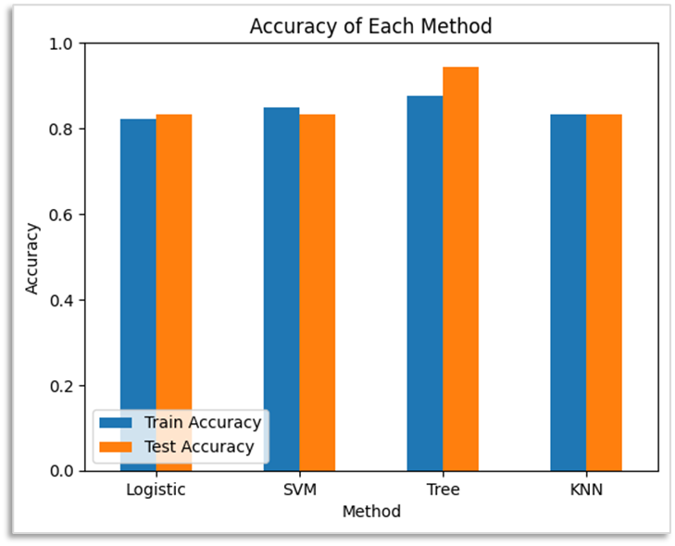
Classification Accuracy
Four classification models were built, and their accuracies are shown in the accompanying figure.
Both the train and test accuracy indices of the Decision Tree Classifier are above 87%, which are the highest values in the chart.

Slide 44
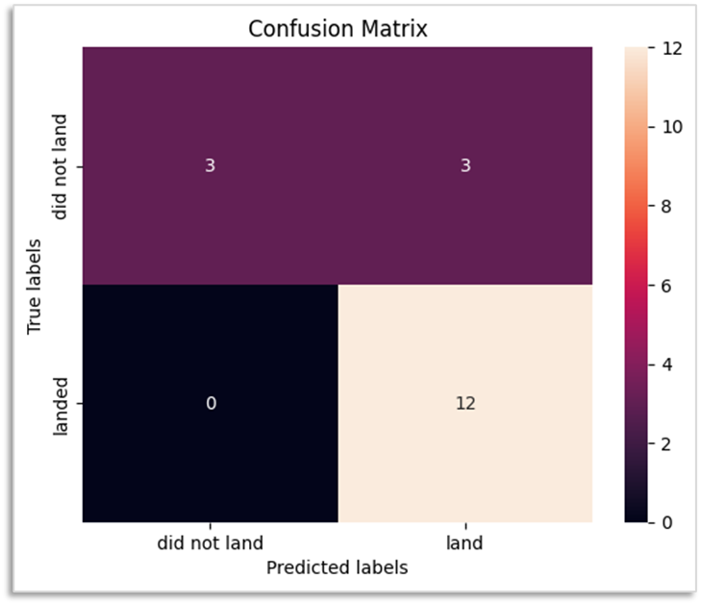
Confusion Matrix of Decision Tree Classifier
The confusion matrix below verifies the accuracy of Decision Tree Classifier due to the large values in true positive and true negative areas compared to false areas

Slide 45
Conclusions
In this project, different data sets were analysed to refine conclusions.
Although GEO, HEO, SSO and ES-L1 orbits have the highest success rates, more data sets are required to analyse patterns or trends before we can draw any conclusion.
KSC LC-39A is the best launch site according to its success rate of launches.
Depending on the orbits, payload mass can be a criterion to consider for the success of a mission. Some orbits required a light or heavy payload mass; however, low weighted payloads performed better than the heavy ones in general.
Successful landing outcomes seem to improve over time.
Decision Tree Classifier can be used to predict successful landings and increase profits because of its accuracy.

Slide 46
Appendix
All Python code, Jupyter notebook, SQL queries, charts and data sets that I have created or analysed during this project can be accessed from https://github.com/LeoThaiHuy/Applied-Data-Science-Capstone.git

Slide 47


